Slide 1
CS5542 Big Data Analytics and Applications Tutorial 8 – MNIST Classification
March 8th 2018
UMKC

Slide 2
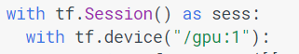
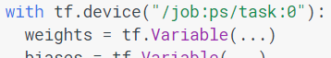
Session
CPU or GPU
Launching the graph in a distributed graph
We can use "with tf.device():" statements to directly specify workers for particular parts of the graph:

Slide 3
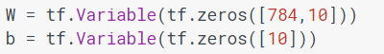
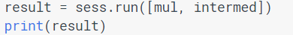
Variables, fetches
Variables maintain state across executions of the graph. It lives in the computation graph
Before Variables can be used within a session, they must be initialized using that session
To fetch the outputs of operations, execute the graph with a run() call on the session object and pass in tensors to retrieve
All the ops needed to produce the values of the requested tensors are run once (not once per requested tensor)

Slide 4
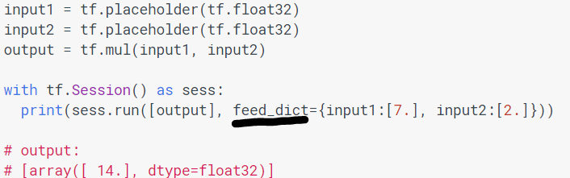
Feeds
feed mechanism for patching a tensor directly into any operation in the graph
A feed temporarily replaces the output of an operation with a tensor value.
Supply feed data as an argument to a run() call

Slide 5
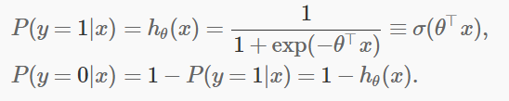
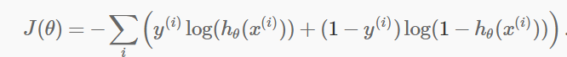
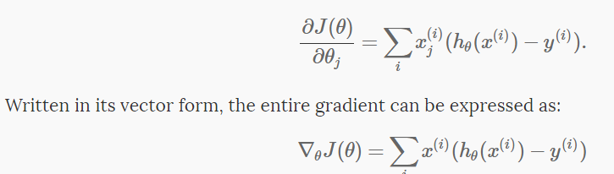
Logistic regression
Learning function
Cost function

Slide 6
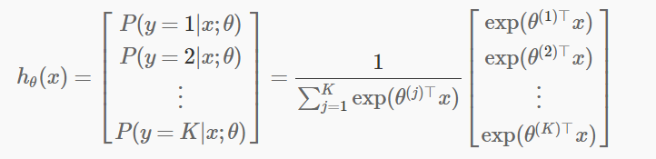
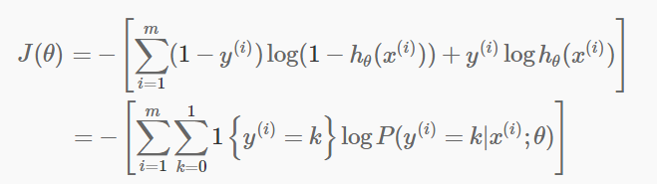
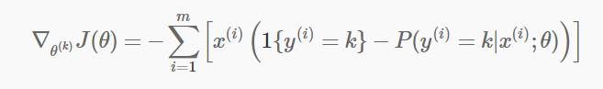
Softmax Regression
Cost function

Slide 7
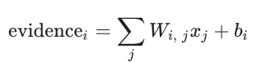
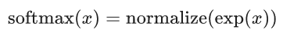
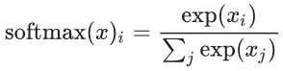
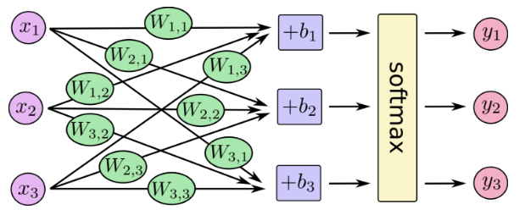
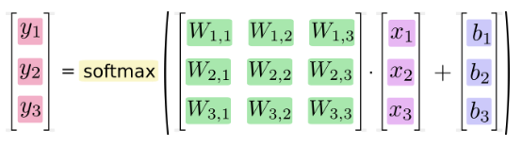
Softmax Regression
Notes:
A softmax regression has two steps: first we add up the evidence of our input being in certain classes, and then we convert that evidence into probabilities.
To tally up the evidence that a given image is in a particular class, we do a weighted sum of the pixel intensities. The weight is negative if that pixel having a high intensity is evidence against the image being in that class, and positive if it is evidence in favor
We also add some extra evidence called a bias. Basically, we want to be able to say that some things are more likely independent of the input.
where Wi is the weights and bi is the bias for class i, and j is an index for summing over the pixels in our input image x.
We then convert the evidence tallies into our predicted probabilities y using the "softmax" function

Slide 8
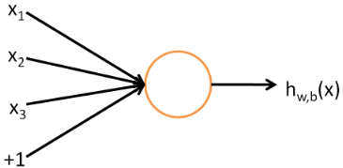
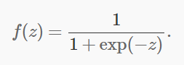
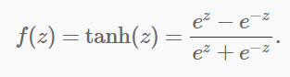
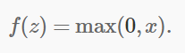
Neural networks
If the activation function is sigmoid function then single neuron corresponds exactly to the input-output mapping defined by logistic regression
Sigmoid, tanh, rectifier

Slide 9
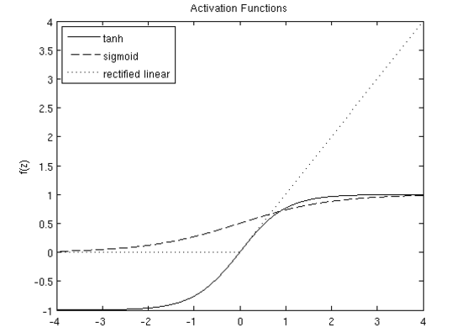
Activation Functions

Slide 10
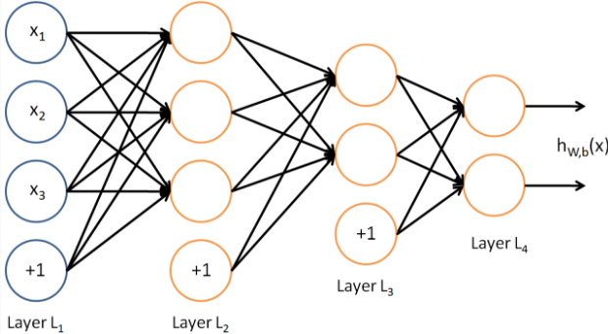
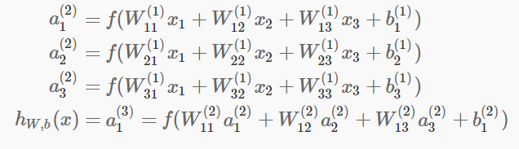
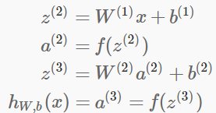
Multi Layer Perceptron
Feed forward

Slide 11
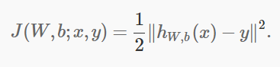
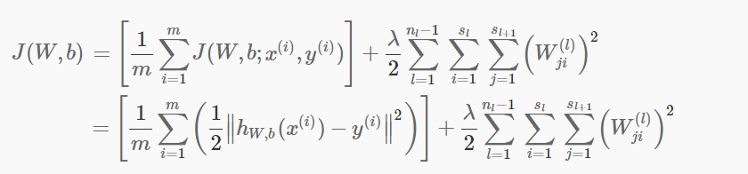
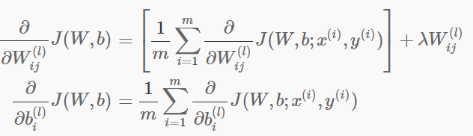
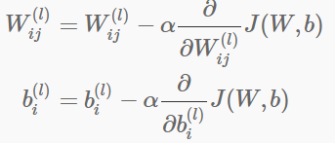
Backpropagation Algo
Regularization
Gradient descent
Derivative of overall cost function

Slide 12
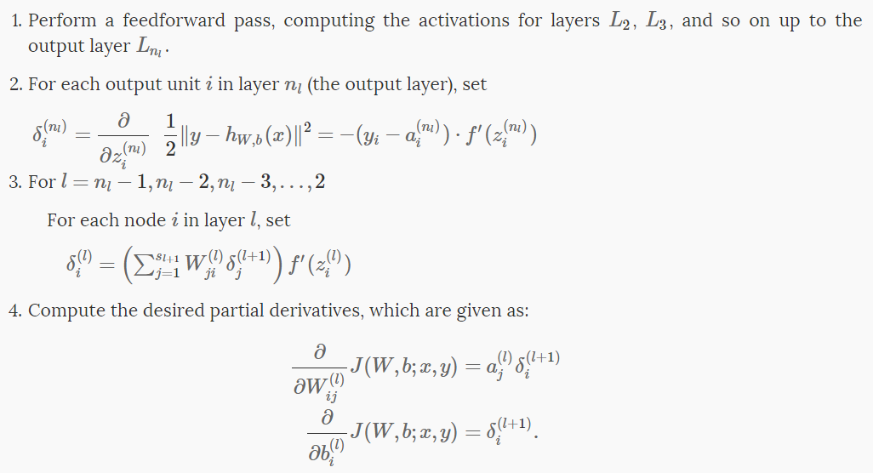
Backpropagation Algo
Backpropagation algorithm gives an efficient way to compute these partial derivatives
Algorithm:

Slide 13
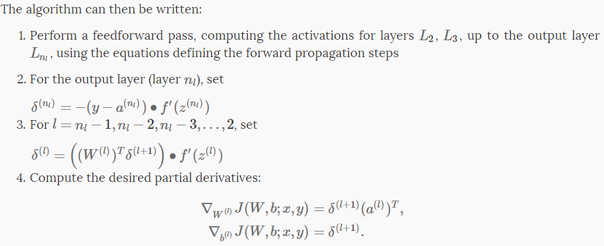
Matrix Vectorial Notation

Slide 14
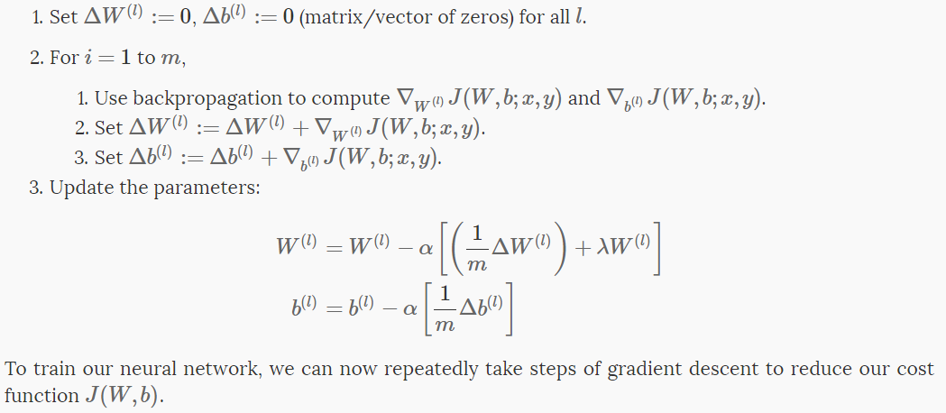
Gradient Descent

Slide 15
Workflow
Learn about the MNIST data and softmax regressions
Create a function that is a model for recognizing digits, based on looking at every pixel in the image
Use Tensorflow to train the model to recognize digits by having it "look" at thousands of examples (and run our first Tensorflow session to do so)
Check the model's accuracy with our test data

Slide 16

MNIST
MNIST is a simple computer vision dataset. It consists of images of handwritten digits like these:
It also includes labels for each image, telling us which digit it is. For example, the labels for the above images are 5, 0, 4, and 1
http://yann.lecun.com/exdb/mnist/

Slide 17
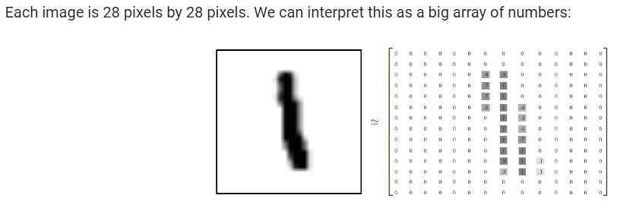
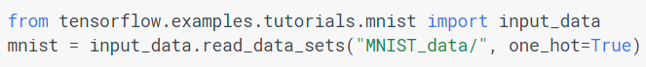
Download and Read Data
55,000 data points of training data (mnist.train), mnist.train.labels, mnist.train.images
10,000 points of test data (mnist.test)
5,000 points of validation data (mnist.validation)

Slide 18
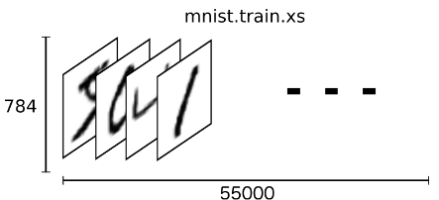
MNIST
mnist.train.images is a tensor (an n-dimensional array) with a shape of [55000, 784]
The first dimension is an index into the list of images and the second dimension is the index for each pixel in each image

Slide 19
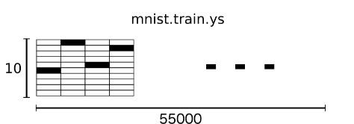
One hot vector
labels as "one-hot vectors“
0 in most dimensions, and 1 in a single dimension
For example, 3 would be [0,0,0,1,0,0,0,0,0,0].
mnist.train.labels is a [55000, 10] array of floats

Slide 20
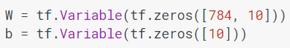
Variables
x = tf.placeholder(tf.float32, [None, 784])
None means that a dimension can be of any length

Slide 21
Cross entropy
numerically stable function internally computes the softmax activation

Slide 22
Training
TensorFlow knows entire graph of your computations
backpropagation algorithm to efficiently determine how your variables affect the loss you ask it to minimize.
apply your choice of optimization algorithm to modify the variables and reduce the loss

Slide 23
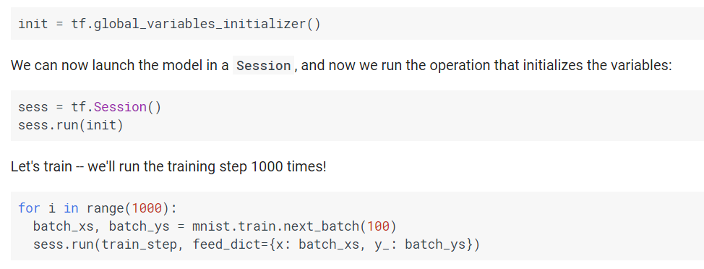
Training
Notes:
Each step of the loop, we get a "batch" of one hundred random data points from our training set. We run train_step feeding in the batches data to replace the placeholders.

Slide 24
Stochastic Gradient Descent
Using small batches of random data is called stochastic training
In this case, stochastic gradient descent
Ideally we should use all data but expensive
Instead we use a different subset every time
Cheap and same benefit

Slide 25
Export the Model
TensorFlow Serving is a flexible, high-performance serving system for machine learning models, designed for production environments.
Exporter module saves a “snapshot” of the trained model so that it can be loaded later for inference.

Slide 26
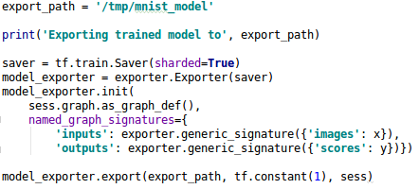
Export
Give local system path

Slide 27
Saver
saver is used to serialize graph variable values to the model export
List of variables to save can be given
sess.graph.as_graph_def() is the protobuf of the graph. Export will serialize graph
named_graph_signatures: specifies a model export signature.

Slide 28
Inference/ Test
Load Saved graph
Restore variables, weights and bias
Import test data
Evaluate: Calculate accuracy

Slide 29
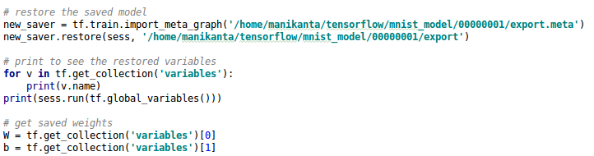
Load saved Graph
Restore method in Saver module
Import graph_def
Restore variables etc.

Slide 30
Evaluation
tf.argmax gives the index of the highest entry in a tensor along some axis
About 91% accuracy

Slide 31
Logging and Monitoring
Internal logging system
Uses five different levels
DEBUG, INFO, WARN, ERROR & FATAL
output all logs of that level and all levels of higher severity

Slide 32
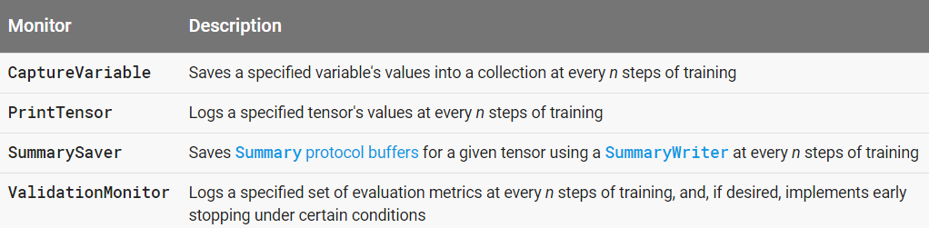
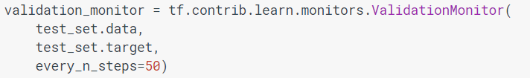
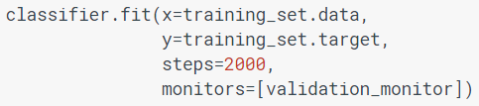
Validation Monitor
tf.contrib.learn provides several high-level Monitors

Slide 33
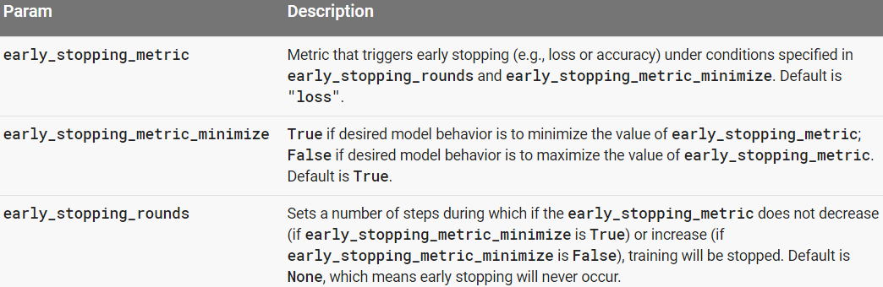
Monitoring
Can customize the list of metrics
E.g.
Early stopping with Validation Monitor

Slide 34
Tensor Board
Reading through the logs
Save training data
http://127.0.1.1:6006
visualize your TensorFlow graph
plot quantitative metrics
show additional data like images that pass through graph

Slide 35
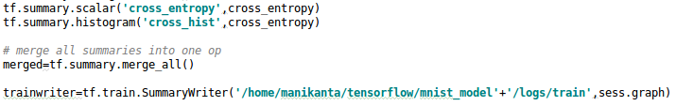
Tensor Board
TensorBoard operates by reading events files
Annotate nodes with summary operations
Attach scalar_summary ops to nodes
Distributions by attaching histogram_summary
use tf.summary.merge_all to combine them into a single op
Use SummaryWriter to write to disk

Slide 36
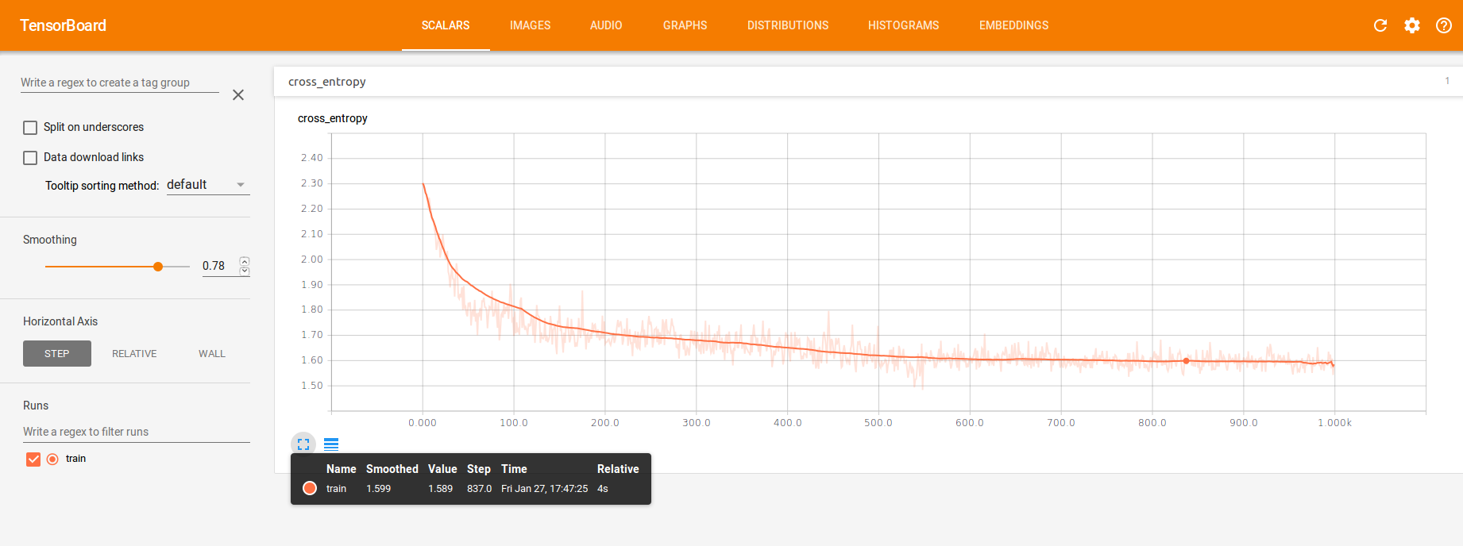
Cross_entropy
Loss

Slide 37
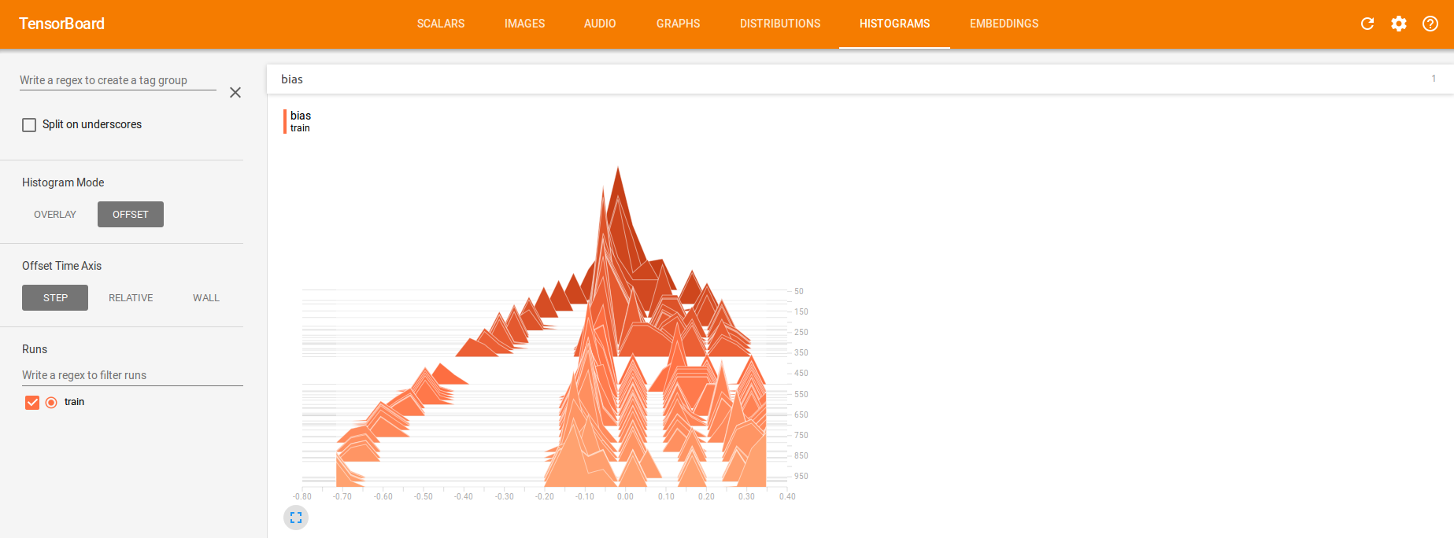
Histograms

Slide 38
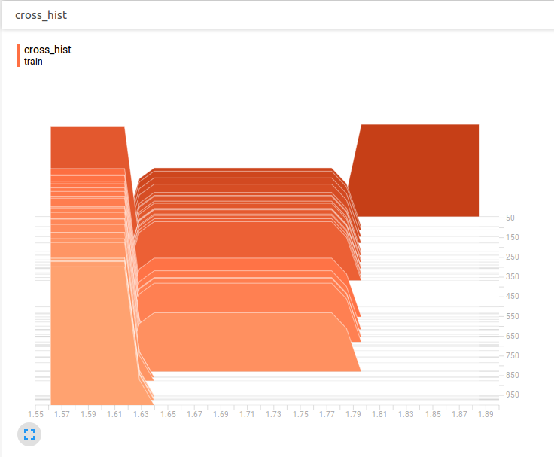
Histogram - loss

Slide 39
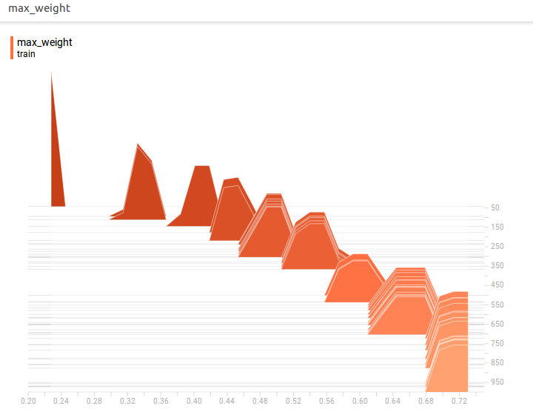
Max Weight

Slide 40
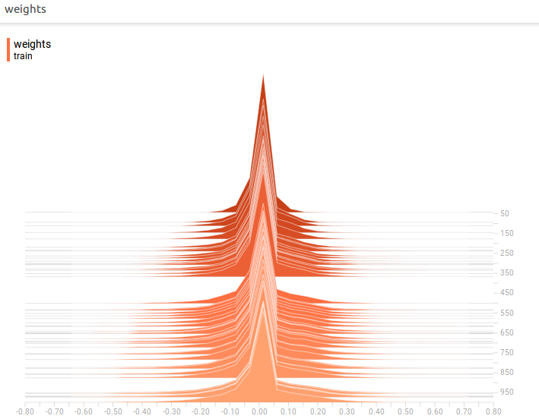
Histogram - Weights

Slide 41
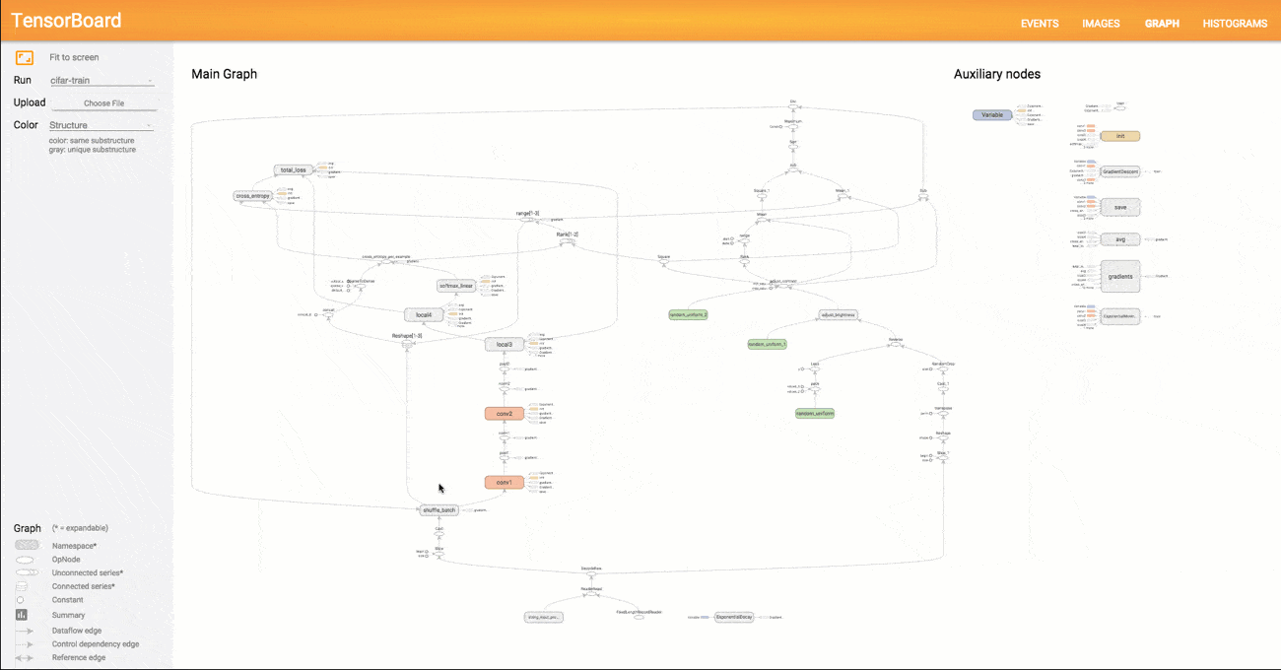
Graph Visualization
Example visualization

Slide 42

Graph Visualization
Typical TensorFlow graphs can have many thousands of nodes
variable names can be scoped
visualization uses this information to define a hierarchy on the nodes in the graph
visualization will collapse all ops into a node with same scope

Slide 43
Graph Visualization
Two kinds of connections:
data dependencies-solid arrows
control dependencies-dotted lines
visualization separates out all high-degree nodes to an auxiliary area on the right
doesn't draw lines to represent their edges

Slide 44

Graph Visualization

Slide 45
Tensor Shape Info
If GraphDef includes tensor shapes,
visualizer labels edges with tensor dimensions
edge thickness reflects total tensor size

Slide 46

MNIST softmax graph

Slide 47


Slide 48
Thank You !!!

